Slide 1
NOTICE
What you are about to see is going to help you learn a new language effectively !!!

Slide 2
SPEAKING
LISTENING
VOCABULARY
&
GRAMMAR
READING
WRITING

Slide 3
LISTENING TO MUSIC
L
S
V/G

Slide 4
WATCHING MOVIES
L
S
V/G

Slide 5
READING NEWS/BOOKS
R
V/G

Slide 6
WRITING STORIES/DIARIES
W
R
V/G

Slide 7
TEACHING FRIENDS
W
R
L
S
V/G

Slide 8
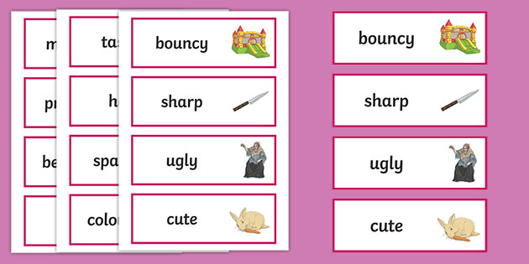
TAKING NOTES
V/G

Slide 9
LEARNING APPS
W
R
L
S
V/G

Slide 10
TALKING TO NATIVE SPEAKERS
L
S
V/G

Slide 11
Dear beloved learners,
“ Practice makes perfect ”
You should keep a good routine of learning at least
15 minutes for revision and 30 minutes for a new lesson.
Everyone has their own learning methods, so above are just my recommendations, you don't have to follow everything.
Choose and create your own ways that suits you the most.
Be patient and Good luck !!!

